Slide 1
Cultivating students’ financial literacy through curriculum planning and implementation in school
透過學校課程規劃及推行以培育學生的理財能力

Slide 2
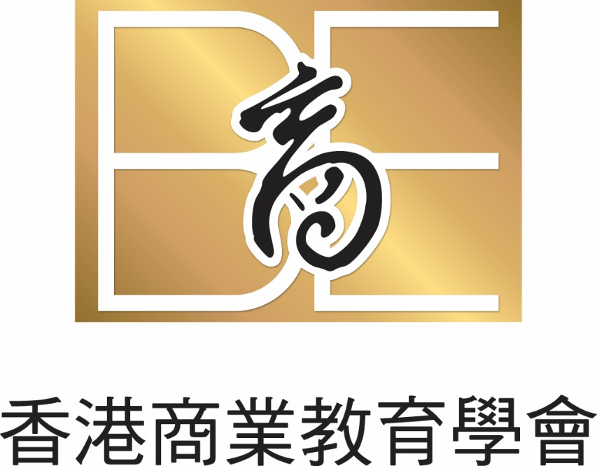
Eric Tai Ming Kee
Chairman of Hong Kong Association for Business Education (HKABE)
14 March 2023
Notes:
1. Study Business Administration, major in Professional Accountancy. No Business Stream in secondary school to choose.
2. 1986 Leaving Accountancy Firm to join the teaching profession. Teaching Principles of Accounts and Commerce for 21 years. 13 years’ of principalship before retirement in 2020.
3. Had been the member of BAFS One Committee to formulate the BAFS Curriculum. Had been the Chairman of HKEAA BAFS Subject. Now Chairman of HKABE

Slide 3
Curriculum planning and implementation in school

Slide 4
Curriculum planning
Following the global financial crisis (GFC) of 2008, a significant focus on financial literacy education (FLE) has emerged from countries around the globe (OECD, 2013).
This includes the establishment of the International Network on Financial Education (INFE), which was endorsed by G20 leaders (G20, 2012). This financial education network meets bi-annually “to discuss the latest developments in their country and to collect evidence, develop analytical and comparative studies, methodologies, good practice, policy instruments and practical guidance on key priority areas” (OECD, 2013, p. 141).
In addition to this network, “the first large-scale international study to assess the financial literacy of young people” (Programme for International Student Assessment (PISA) 2012 Financial Literacy Framework (FLF)) has been established (OECD, 2013, p. 139).
Indeed, increasing financial literacy levels to improve financial well-being is of global concern (OECD, 2013) and is regularly identified as a core life skill for everyone (Kezar and Yang 2010; ASIC, 2011; Atkinson and Messy, 2012).

Slide 5
Curriculum planning
After the Global Financial Crisis, many governments around the globe realised Financial Literacy Education had not been a priority subject. It was either not being taught or was being taught in such a way that it was hard to gauge knowledge levels since students were not being assessed on this subject. In other words, it was an optional part of the curriculum.
For example, in Australia, to help improve financial literacy, the Government launched the National Financial Literacy Strategy (NFLS) in 2011 (Australian Securities and Investment Commission (ASIC), 2011).
Consumer and financial literacy has been defined as “the application of knowledge, understandings, skills and values in consumer and financial contexts and the related decisions that impact on self, others, the community and the environment” (Hession et al. 2009 p. 1). It is now being viewed as ‘core curriculum’ or as essential learnings for all young Australians in schools (Hession et al. 2009).

Slide 6
Curriculum planning
About the IFEC (投資者及理財教育委員會) in Hong Kong
The Investor and Financial Education Council (IFEC) is a public organisation and a subsidiary of the Securities and Futures Commission (SFC 證監會) , dedicated to improving financial literacy in the HKSAR. The IFEC is supported by the four financial regulators as well as the Education Bureau.
The IFEC promotes and delivers free and impartial investor and financial education resources and programmes through its consumer education platform, The Chin Family. It also leads the Financial Literacy Strategy to create a conducive environment for stakeholders to deliver more quality investor and financial education to the Hong Kong public.
Our Mission
Our mission is to equip the public with the knowledge, attitude and skills necessary for making informed investment and financial decisions and managing money wisely.
Our partners
We consult and work in partnership with government agencies and the financial services, education and community sectors to identify pressing investor and financial education needs among various target groups. Together with our partners, we design initiatives that raise financial literacy levels and strengthen financial resilience.

Slide 7
A. Curriculum planning
Financial Education Coordination Committee
理財教育統籌委員會
Organisations that are actively engaged in financial education join the Committee. Members come from different sectors, including the government and related organisations, regulators, financial institutions, industry associations and professional bodies as well as NGOs, etc.
They agree to support the Financial Literacy Strategy in the following ways:
align their organisations’ financial education directions with the Strategy and assist in the delivery of core actions of the Strategy where possible;
share best practices in financial education;
help identify financial literacy issues; and
provide feedback to the IFEC on the Strategy.

Slide 8
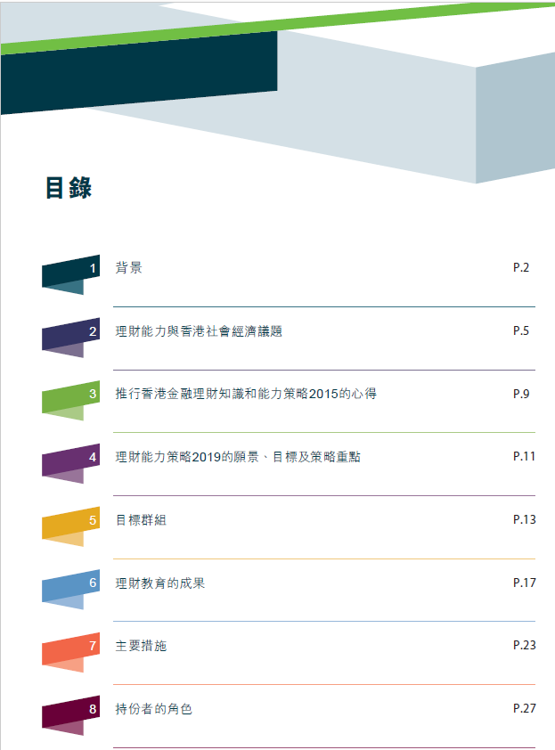
Curriculum planning

Slide 9
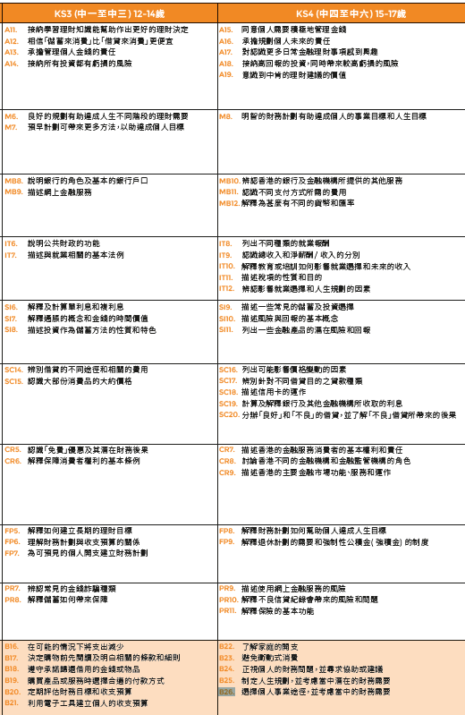
Curriculum planning

Slide 10
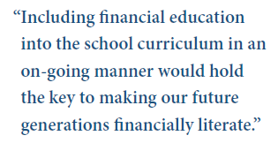
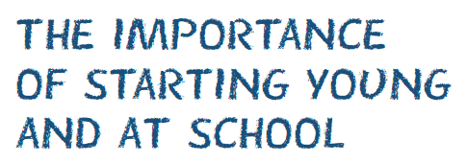
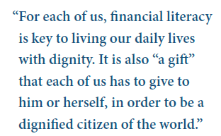
Curriculum planning
Notes:
In 2005, during development of New Secondary Curriculum, Personal Financial Management was suggested to be compulsory and included in Liberal Studies. Finally suggestion rejected.

Slide 11
Curriculum planning
Financial education in schools should be part of a co-ordinated national strategy. The strategy should have a visible leader or co-ordinating body to ensure relevance and long term sustainability.
There should be a learning framework which sets out goals, learning outcomes, content, pedagogical approaches, resources and evaluation plans. The content should cover knowledge, skills, attitudes and values.
To the extent possible, a sustainable source of funding should be identified at the outset.
Financial education should start as early as possible, ideally from the beginning of formal schooling, and carry on until the end of the students’ time at school.
Financial education should ideally be a core part of the school curriculum. It can be, but need not be, taught as a ‘stand-alone’ subject; integration into other subjects like mathematics, economics, social science or citizenship can also be effective.
Teachers should be adequately trained and resourced, and made aware of the importance of financial literacy and relevant pedagogical methods.
There should be easily accessible, objective, high-quality and effective learning tools and pedagogical resources available to schools and teachers.
Students’ progress should be assessed and their achievements recognised.
Notes:
In 2005, during development of New Secondary Curriculum, Personal Financial Management was suggested to be compulsory and included in Liberal Studies. Finally suggestion rejected.

Slide 12
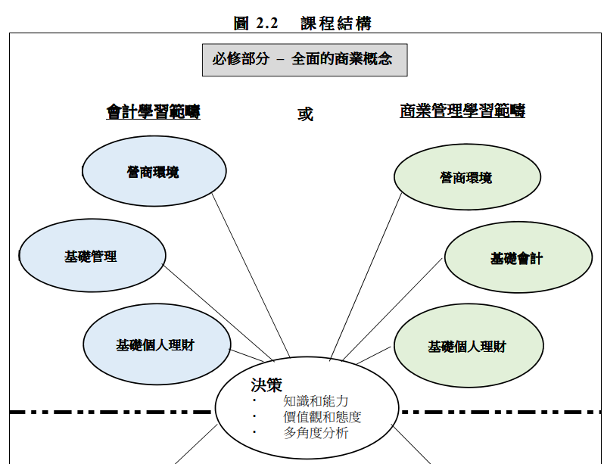
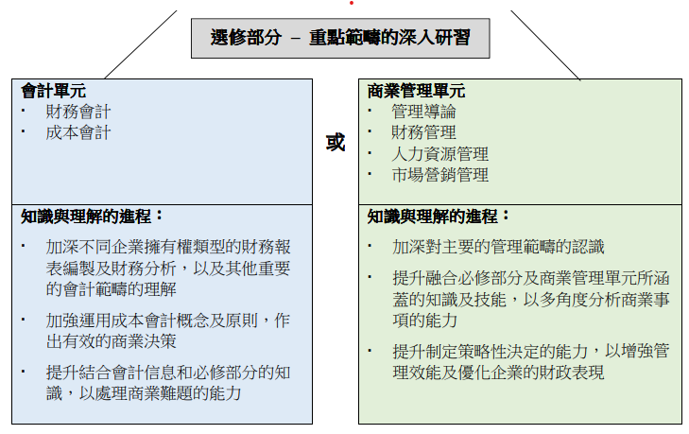
Implementation in School
Senior Secondary: HKDSE Elective Subject
Business, Accounting and Financial Studies (BAFS) 企業、會計與財務概論
Basics of Personal Financial Management
Notes:
In 2005, during development of New Secondary Curriculum, Personal Financial Management was suggested to be compulsory and included in Liberal Studies. Finally suggestion rejected.

Slide 13
Implementation in School
Senior Secondary: HKDSE Elective Subjects
In 2022, there are 41,610 day school candidates attending English Subject
 | Elective Subjects | No. of day school candidates | % of candidates / English Subject
1 | Biology | 11,863 | 28.5%
2 | Chemistry | 10,952 | 26.3%
3 | Economics | 10,762 | 25.9%
4 | Physics | 9,144 | 22.0%
5 | Business, Accounting and Financial Studies | 6,223 + 2,454 = 8,677 | 20.9%
Notes:
In 2005, during development of New Secondary Curriculum, Personal Financial Management was suggested to be compulsory and included in Liberal Studies. Finally suggestion rejected.

Slide 14
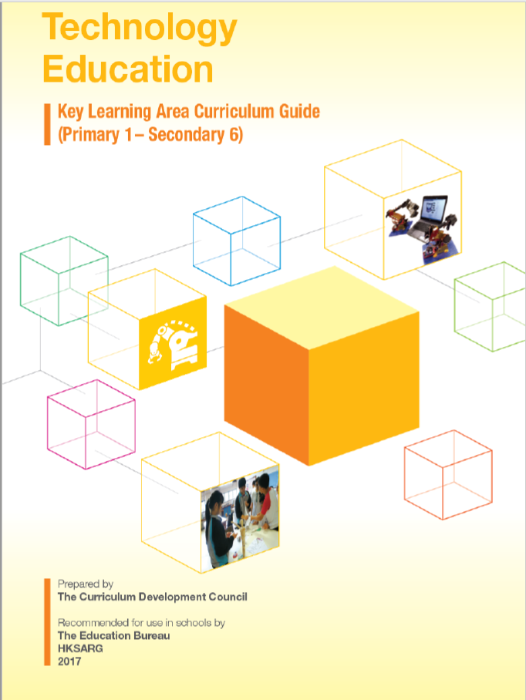
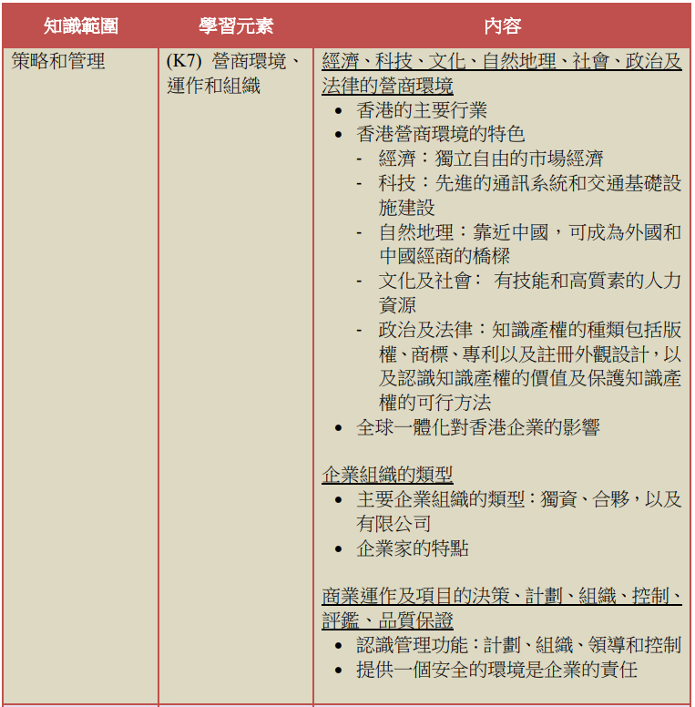
Implementation in School
Junior Secondary: Liberal Studies, Life and Society, Business Studies/BAFS
Core Modules K7 in F.3
Notes:
In 2005, during development of New Secondary Curriculum, Personal Financial Management was suggested to be compulsory and included in Liberal Studies. Finally suggestion rejected.

Slide 15
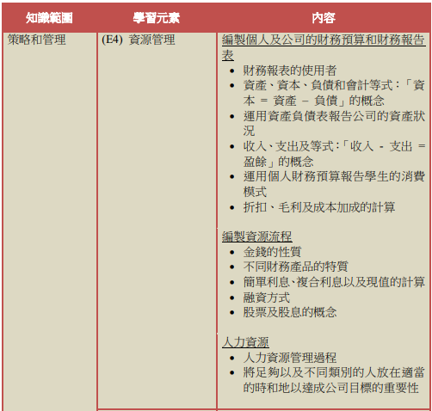
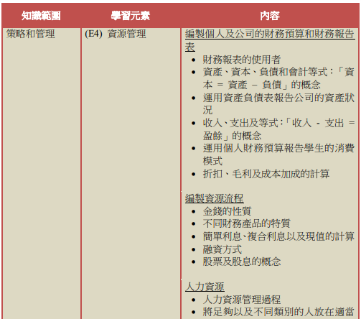
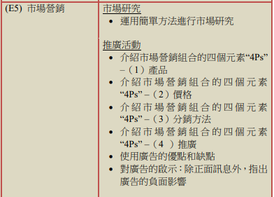
Implementation in School
Junior Secondary: Liberal Studies, Life and Society, Business Studies/BAFS
Extended Modules E4 in F.3
Extended Modules E5 in F.3
Notes:
In 2005, during development of New Secondary Curriculum, Personal Financial Management was suggested to be compulsory and included in Liberal Studies. Finally suggestion rejected.

Slide 16
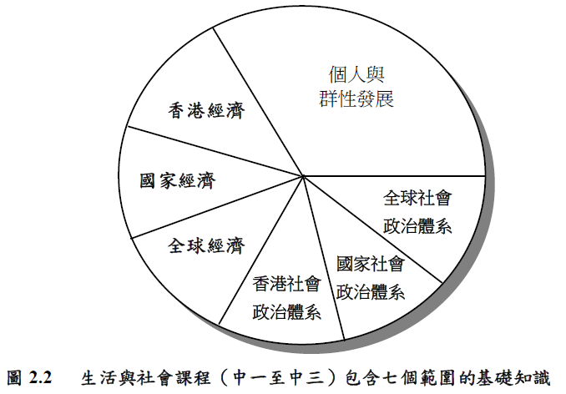
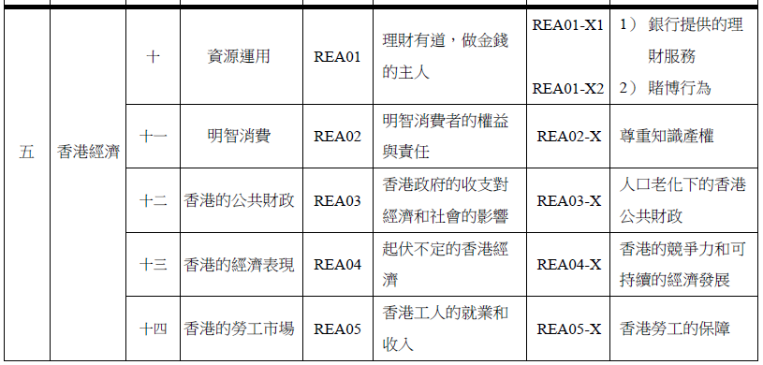
Implementation in School
Junior Secondary:
Life and Society
生活與社會
F.1-F.3
Notes:
In 2005, during development of New Secondary Curriculum, Personal Financial Management was suggested to be compulsory and included in Liberal Studies. Finally suggestion rejected.

